Slide 1
Kans Collections Project
A Social Media Model Sari Marketing Website.

Slide 2
Features of the Website:
Login Page
Home Page
Feedback Page
Theme Upload
Pick Page
Design Upload
Search
Delete
Music page

Slide 3
Spring Specialty
Standalone Vs Enterprise Level Application
Functional Vs Non-functional Requirement
IOC/Dependency injection
Java Beans Vs Spring Beans
Variety:
Spring Core
Spring MVC
Spring Rest
Spring Boot
Spring ORM
Spring Rest

Slide 4
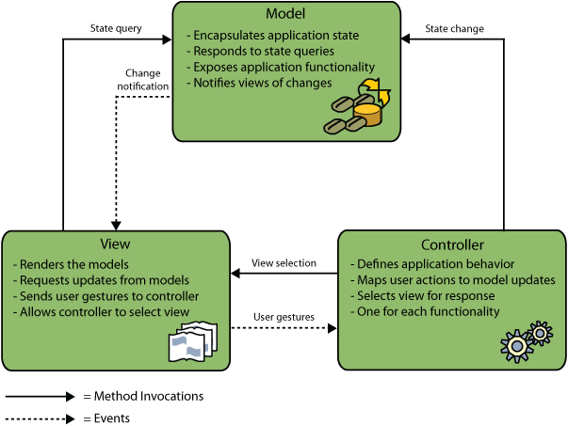
Spring MVC- How is it relevant in this project?

Slide 5
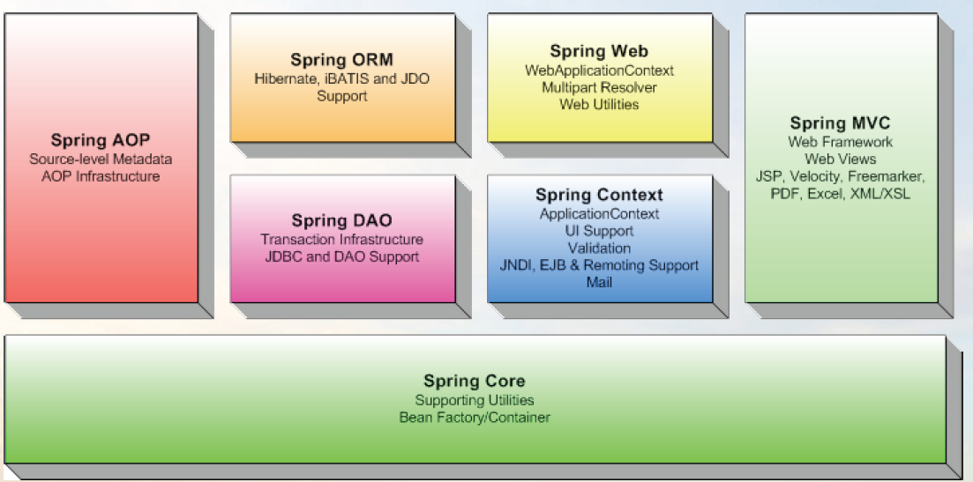
Spring Modules

Slide 6
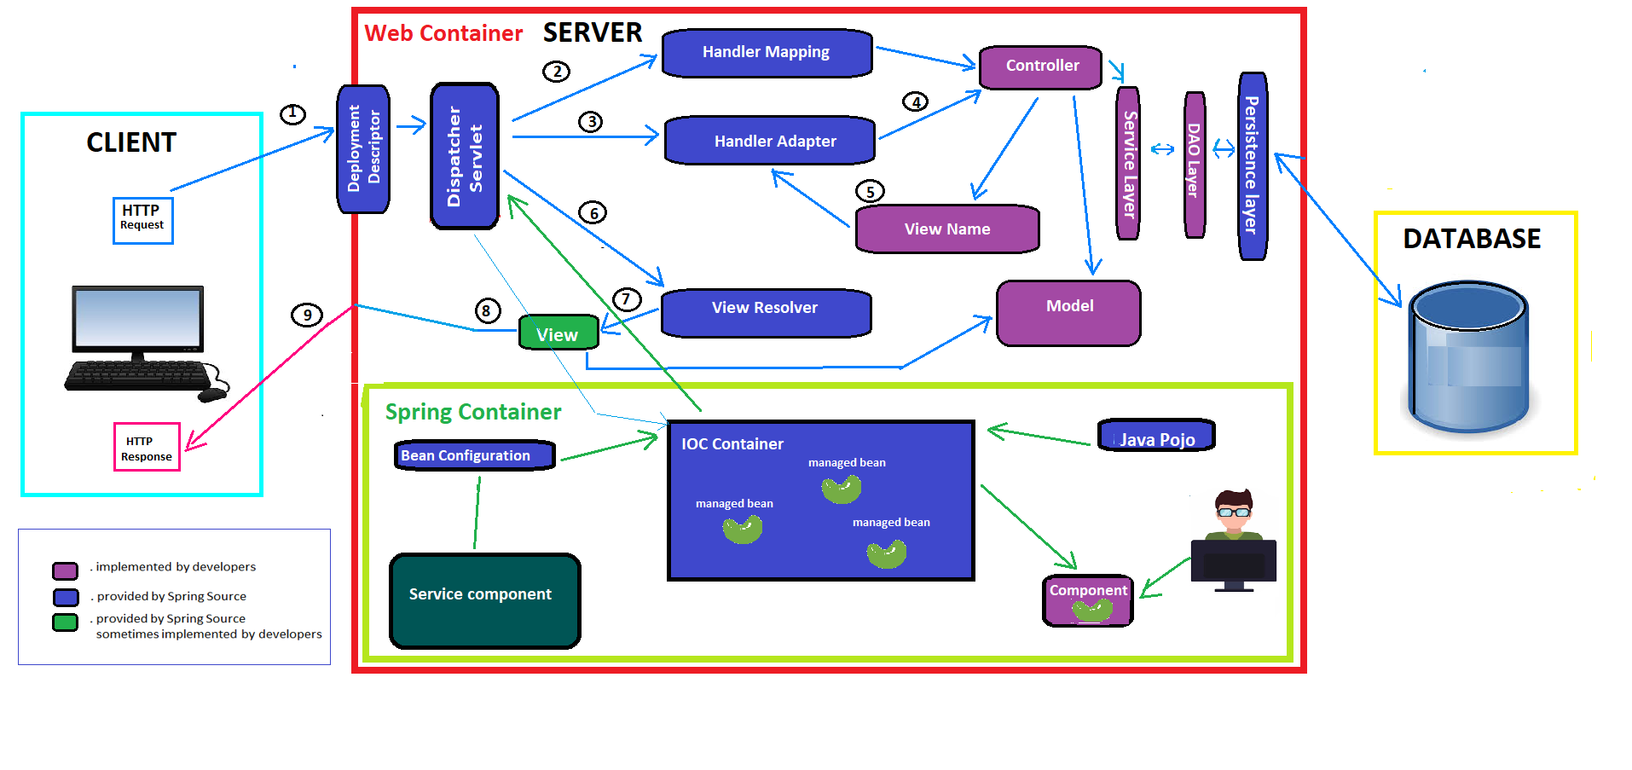
Spring Architecture

Slide 7
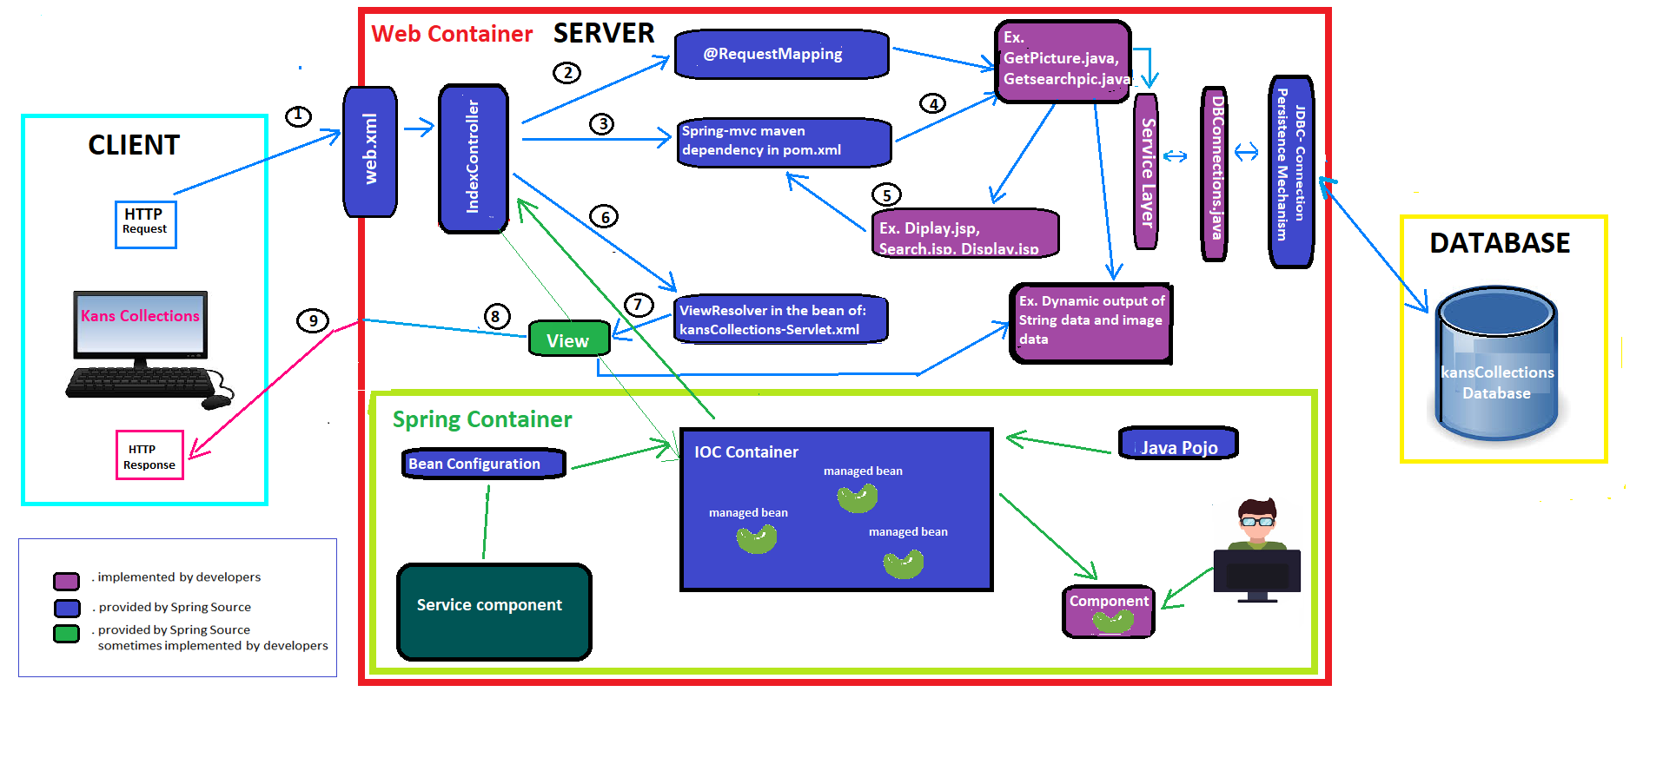
Spring Architecture for Kans Collections

Slide 8
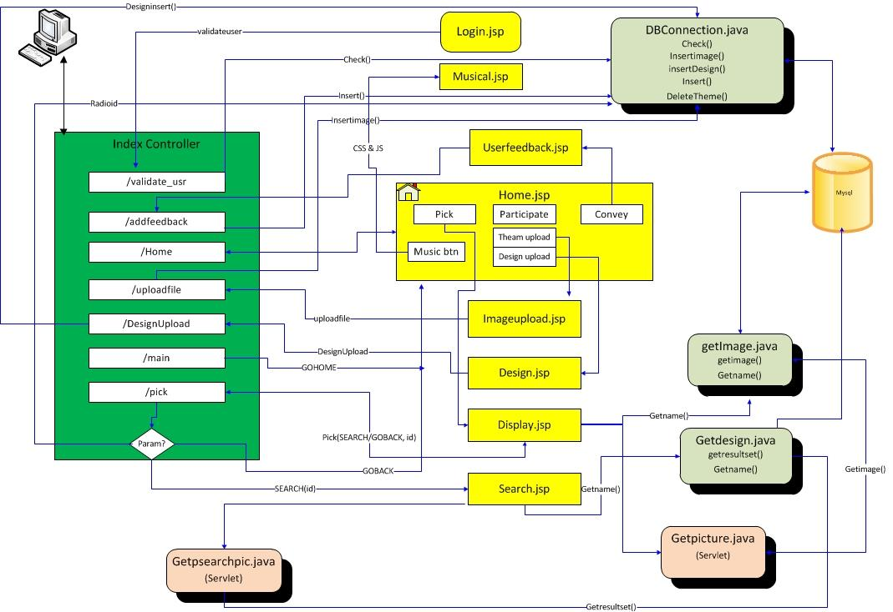
Kans Collection Project Workflow

Slide 9
Thank You!

